Slide 1
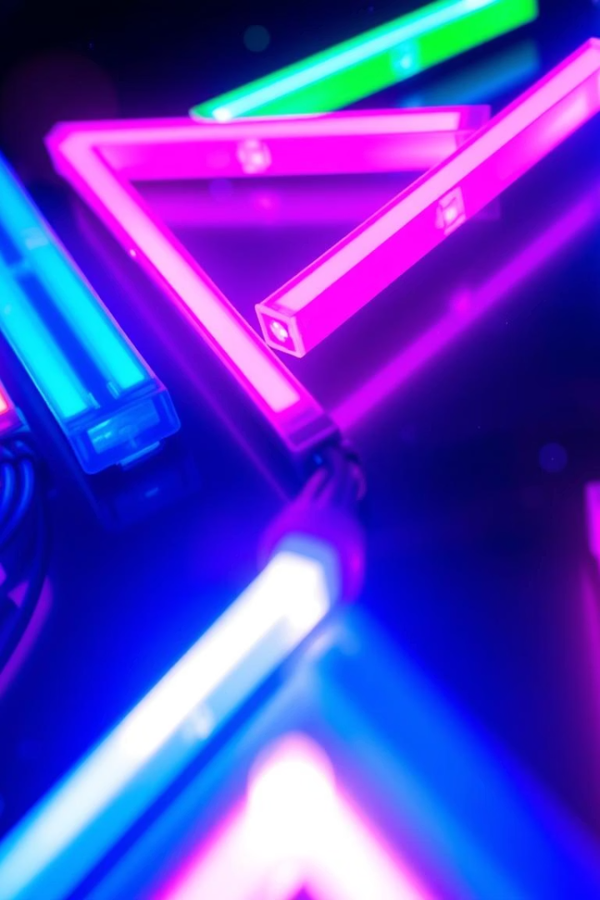
Electronic Frills: Design and Implementation
Project Title: Dynamic LED Pattern Generation using Shift Registers & Counters.
Adhil Hashim
Guide: Dr. Gurleen Kaur Walia

Slide 2
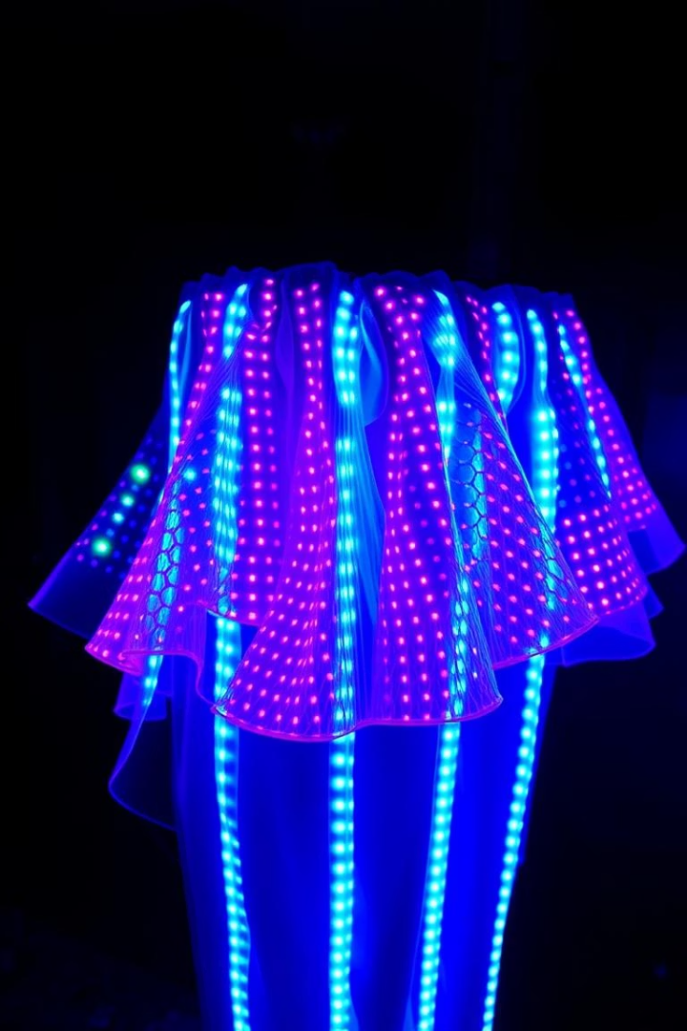
Introduction & Motivation
What are Electronic Frills?
Why Dynamic LED Patterns?
Decorative or aesthetic electronic elements designed to enhance visual appeal and attract attention in various settings. They incorporate lights and patterns that bring an interactive and modern touch to traditional displays.
Dynamic LED patterns offer customizable and visually stimulating effects that can be tailored to different moods or themes. These patterns increase engagement and can transform any environment by adding vibrant and ever-changing lighting effects.
Real-World Uses
Applications include home decor to create ambiance, signage to attract customers, event displays for immersive experiences, and art installations that use lighting as a medium to tell a story or evoke emotions. The adaptability of LED patterns allows creative expression in multiple domains.

Slide 3
Objectives & Scope
Key Goals
Scope & Future
Design diverse LED patterns that are visually appealing and customizable for different applications.
Start with a small-scale demonstration featuring a limited number of LEDs to validate the concept.
Minimize I/O pins usage to optimize hardware efficiency and reduce complexity in circuit design.
Plan scaling up the design to accommodate larger LED arrays for more complex pattern generation.
Develop a flexible system architecture that supports easy modifications and expansions.
Integrate microcontroller units to enhance control capabilities and enable programmability.
Ensure reliable and stable operation of the LED patterns under various conditions.
Explore potential real-world applications such as decorative lighting, signage, and interactive displays.
Consider future improvements like wireless control and sensor integration for dynamic responsiveness.

Slide 4
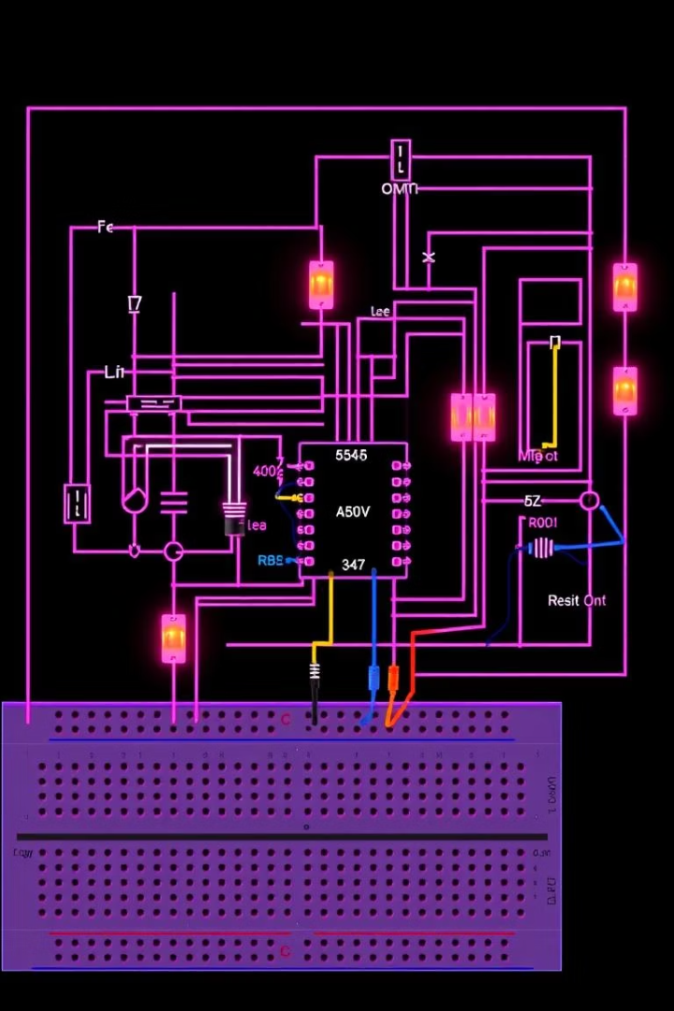
Theory: 555 Timer & Shift Registors
555 Timer
The 555 timer IC is a highly stable device used to generate precise time delays and oscillations. In astable multivibrator mode, it continuously switches between high and low states, producing a square wave clock signal used to drive other sequential circuits.
Frequency Formula-
The output frequency of the 555 timer in astable mode is determined by the values of two resistors (R1 and R2) and a capacitor (C).
The formula, f = 1.44 / ((R1 + 2R2) * C), allows designers to calculate the oscillation frequency to tailor the clock speed as needed for the application.
Shift Register - 74HC595
The 74HC595 shift register is a versatile component that enables efficient control of multiple output devices, such as LEDs, from a limited number of microcontroller pins. This integrated circuit converts serial input data into parallel output, allowing for the simultaneous control of multiple output devices.
The shift register operates by shifting bits in sync with clock and latch signals, enabling the creation of complex and dynamic LED patterns. This functionality is particularly useful in applications where pattern complexity is essential, such as LED matrix displays or LED-based lighting effects.
By utilizing the 74HC595 shift register, designers can enhance the capabilities of their projects, reducing the number of required microcontroller pins and simplifying the overall circuit design. This component plays a crucial role in the development of innovative electronic projects that involve dynamic LED-based displays or lighting effects.
Counter IC - 74HC4017
The 74HC4017 is a decade counter IC that counts from 0 to 9. It generates sequential outputs, activating one output pin at a time in response to the incoming clock signal from the 555 timer. This IC simplifies the process of generating timing sequences and dividing frequencies.

Slide 5
Circuit Design: Clock & Counter
555 Timer Astable Circuit
74HC4017 Counter
Schematic with resistor and capacitor values (R1, R2, C).
Wiring diagram showing clock input and LED outputs.
Frequency example: 1Hz for clear visual effect.
LEDs arranged linearly or in circular patterns.

Slide 6
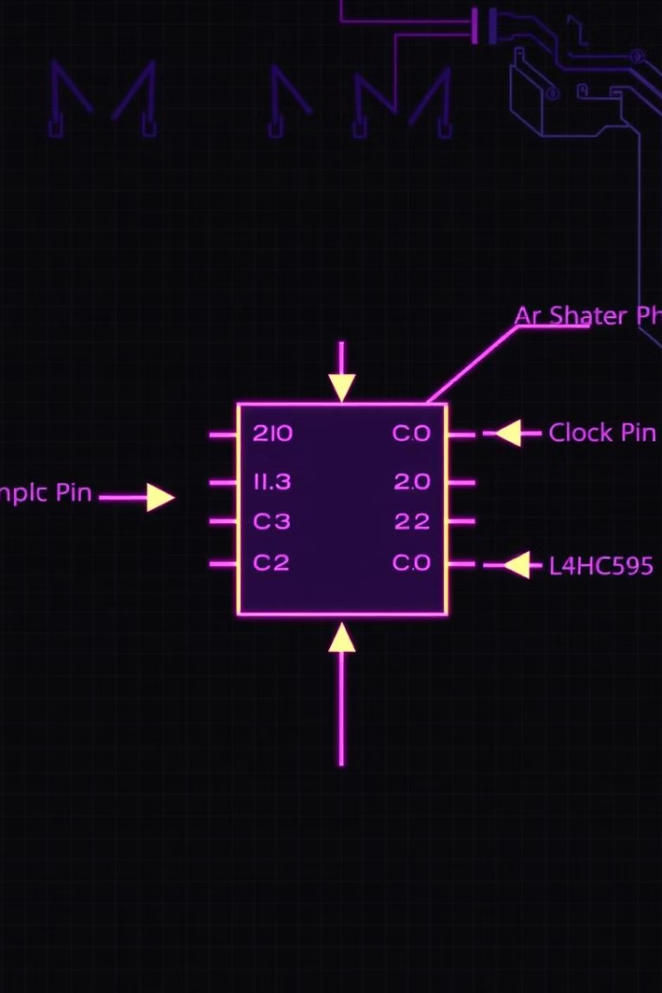
Circuit Design: Shift Register
Serial Data Input
Cascading Shift Registers
Data is fed serially into the shift register to create LED patterns. This serial data input allows each bit to be shifted sequentially through the register, controlling the output pins with precise timing.
Multiple 74HC595 devices can be connected in cascade to extend the number of outputs. This allows designers to control long LED sequences or large displays using only a few microcontroller pins, simplifying wiring and increasing scalability.
Pattern Example
A simple on/off sequence propagation demonstrates how bits move through the shift register outputs. This mechanism enables dynamic and complex lighting effects by controlling the timing and pattern of the LEDs turning on and off.

Slide 7
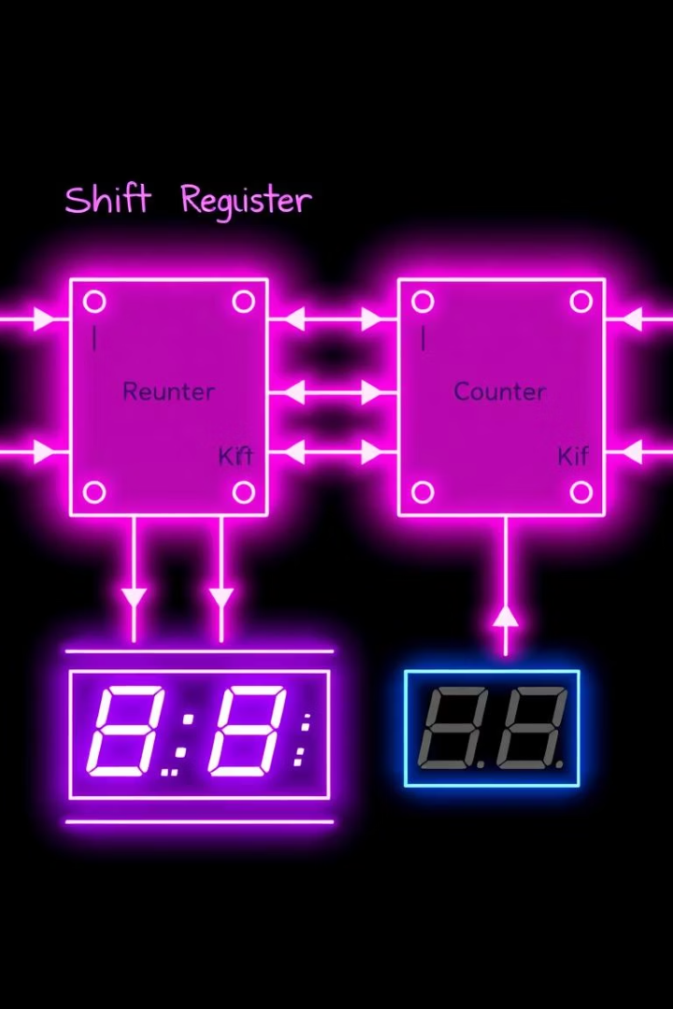
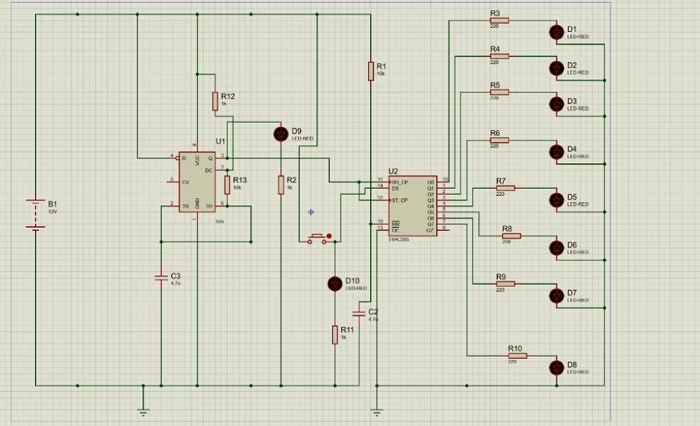
Circuit Diagram
This diagram integrates the 555 timer and shift registers with LED connections.

Slide 8
Components Details-
Power Source (B1):
12V DC supply powers the entire circuit.
555 Timer IC (U1):
Configured in astable mode to generate continuous clock pulses.
Timing Components:
  R12, R13, and C3 set the pulse frequency for the 555 Timer.
Shift Register (U2 - 74HC595):
Receives clock pulses and serial data to drive the LEDs in sequence.
Data and Clock Inputs:
  Clock pulse from 555 timer fed into SRCLK (Shift Register Clock Pin) of 74HC595.
  Data fed into SER (Serial Data Input Pin).
LEDs (D1–D8):
Eight LEDs connected to shift register outputs (Q0–Q7) through current-limiting resistors (R3–R10).
Push Button:
Connected for manual reset or data load trigger.
Indicators (D9 and D10):
LEDs connected for additional visual indicators (possibly latch or status indicators).
Additional Capacitors (C4):
Used for power stabilization across the shift register.
Overall Functionality:
  555 Timer produces continuous pulses.
  Pulses shift the data inside 74HC595.
  LEDs light up in a running pattern depending on the data stream.

Slide 9



Results: Observed Patterns
Chasing Effect
LEDs light up in a smooth, sequential order, creating a dynamic visual trail that appears to chase around the circuit. This effect demonstrates precise timing control and synchronization through the shift register.
Fading Effect
LEDs gradually brighten and dim in a soft, continuous fade, producing an appealing and fluid illumination transition. This pattern highlights the ability to create varying intensity levels to enhance visual effects.
Custom Patterns
Unique LED sequences showcase creative designs tailored by varying the input data. These patterns illustrate the flexibility of the shift register to produce diverse and complex lighting behaviors for different applications.

Slide 10

Challenges & Solutions
Component Selection
Choosing compatible and reliable ICs and LEDs to ensure stable operation and longevity of the circuit was critical. This involved extensive research on the electrical characteristics and sourcing high-quality parts to prevent failure.
Circuit Debugging
Conducting systematic troubleshooting to identify and fix electrical and wiring issues required patience and precision. Techniques such as signal tracing and use of test equipment helped resolve unexpected behavior and shorts in the circuitry.
Pattern Synchronization
Achieving precise timing coordination between the 555 Timer pulses and shift register data was essential for smooth and visually appealing LED sequences. Calibration and fine-tuning of frequency components ensured the patterns ran without glitches or flicker.

Slide 11
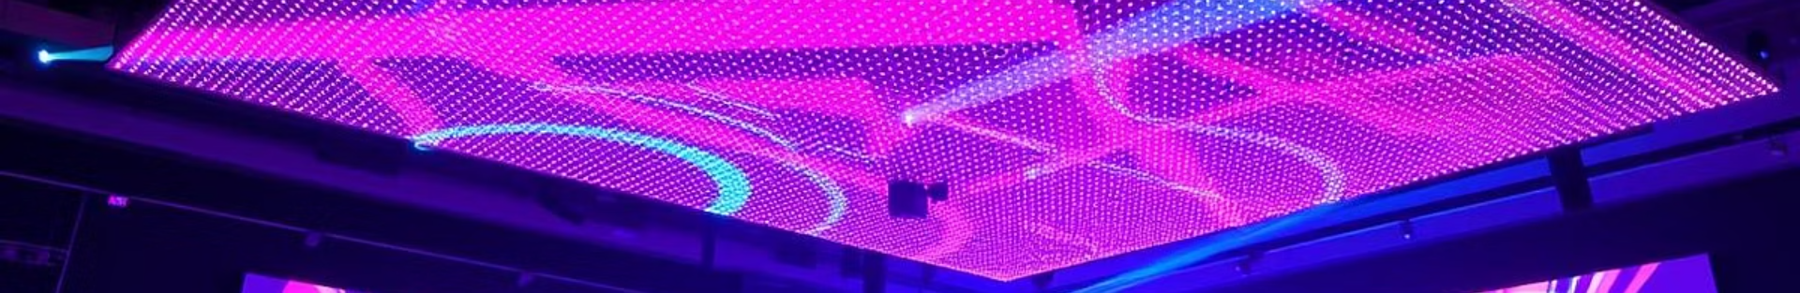
Conclusion & Future Work
Project Summary
Future Enhancements
Applications
Success in pattern generation and pin minimization.
Integration with microcontrollers and larger displays.
Commercial use in decor, events, and interactive art.
We achieved efficient control of LED sequences using a minimal number of pins, demonstrating effective use of the 74HC595 shift register with the 555 Timer.
Future development includes connecting the system to microcontrollers such as Arduino or Raspberry Pi for advanced programmable control.
The demonstrated technology can be utilized in architectural lighting, stage effects, and immersive art installations.
Its scalability and programmability make it suitable for customizable and dynamic environments in commercial and creative industries.
The resulting patterns were visually appealing and validated the theoretical design principles implemented in the circuit.
Expanding to larger LED matrices and incorporating wireless communication can offer more complex and interactive lighting applications.

